Slide 1

Department of computer Application University Institute of Technology Rajiv Gandhi Proudyogiki VishwaVidyalaya
A MAJOR PROJECT PRESENTATION
ON
REAL HAND GESTURE RECOGNITION
SUBMITTED TO : SUBMITTED BY:
DEPARTMENT OF COMPUTER APPLICATION AMRITA SONI
PROJECT GUIDED BY CLASS:MCA
MR. JAY NARAYAN THAKRE 4th sem
ASSISTANT PROFESSOR

Slide 2
Index
Introduction
Objectives
Modules
Tools and Technologies used
Data Flow Diagram
Importance
Output Screens
Future Scope
Conclusion

Slide 3
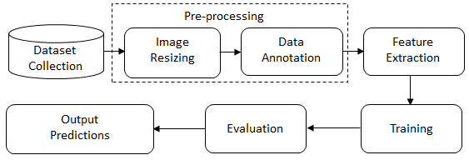
Introduction
Hand gesture recognition is a fascinating field that involves the identification and interpretation of hand movements and poses to understand the intended meaning behind them
It enables natural and intuitive interaction between humans and machines, revolutionizing various domains, including gaming, virtual reality, robotics translation.
General steps :

Slide 4
Objectives
project aims to develop a robust and efficient hand gesture recognition system capable of accurately recognizing and interpreting hand gestures in real-time.
The key objectives of our project include:
Real-time detection and tracking of hand movements
Extraction of relevant features from the hand gestures
Classification and recognition of various hand gestures

Slide 5
Prerequisites for this project
Python
OpenCV
MediaPipe
Tensorflow
Numpy

Slide 6
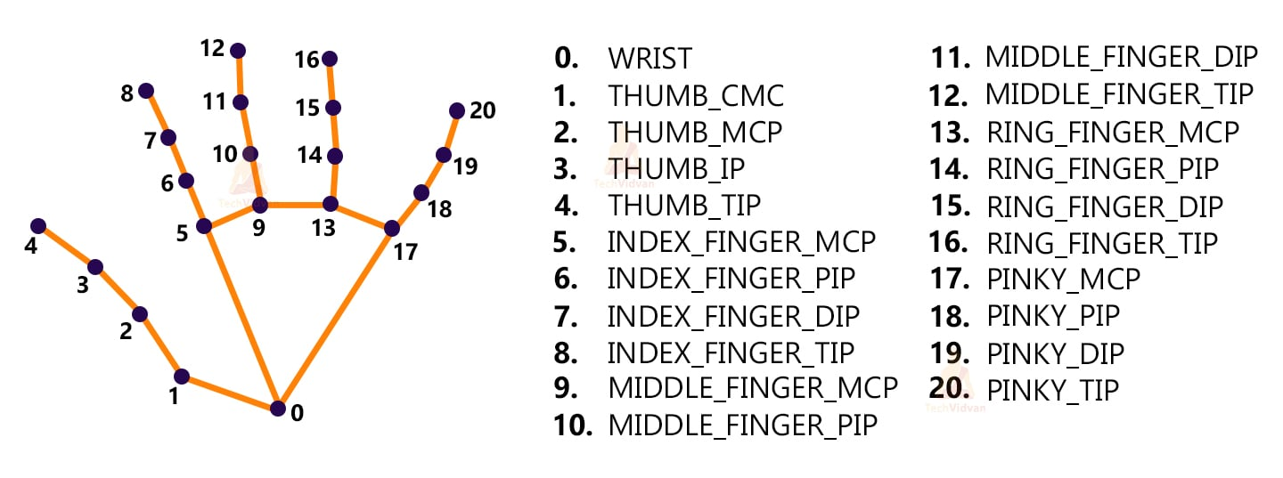
MediaPipe returns a total of 21 key points for each detected hand.

Slide 7
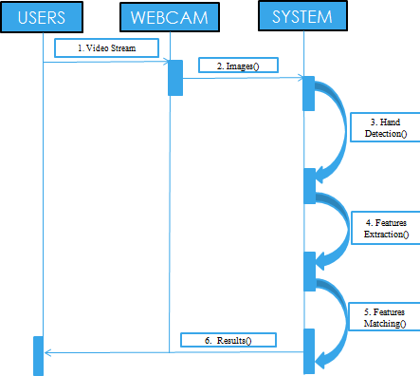
Diagram

Slide 8
Importance and Benefits
Enhanced Human-Computer Interaction:
Hand gesture recognition provides a natural and intuitive means of interacting with computers, eliminating the need for physical devices such as keyboards or mice.
Virtual Reality and Gaming:
Hand gesture recognition enables more immersive experiences in virtual reality environments and enhances gameplay in the gaming industry.

Slide 9
Output Screens

Slide 10
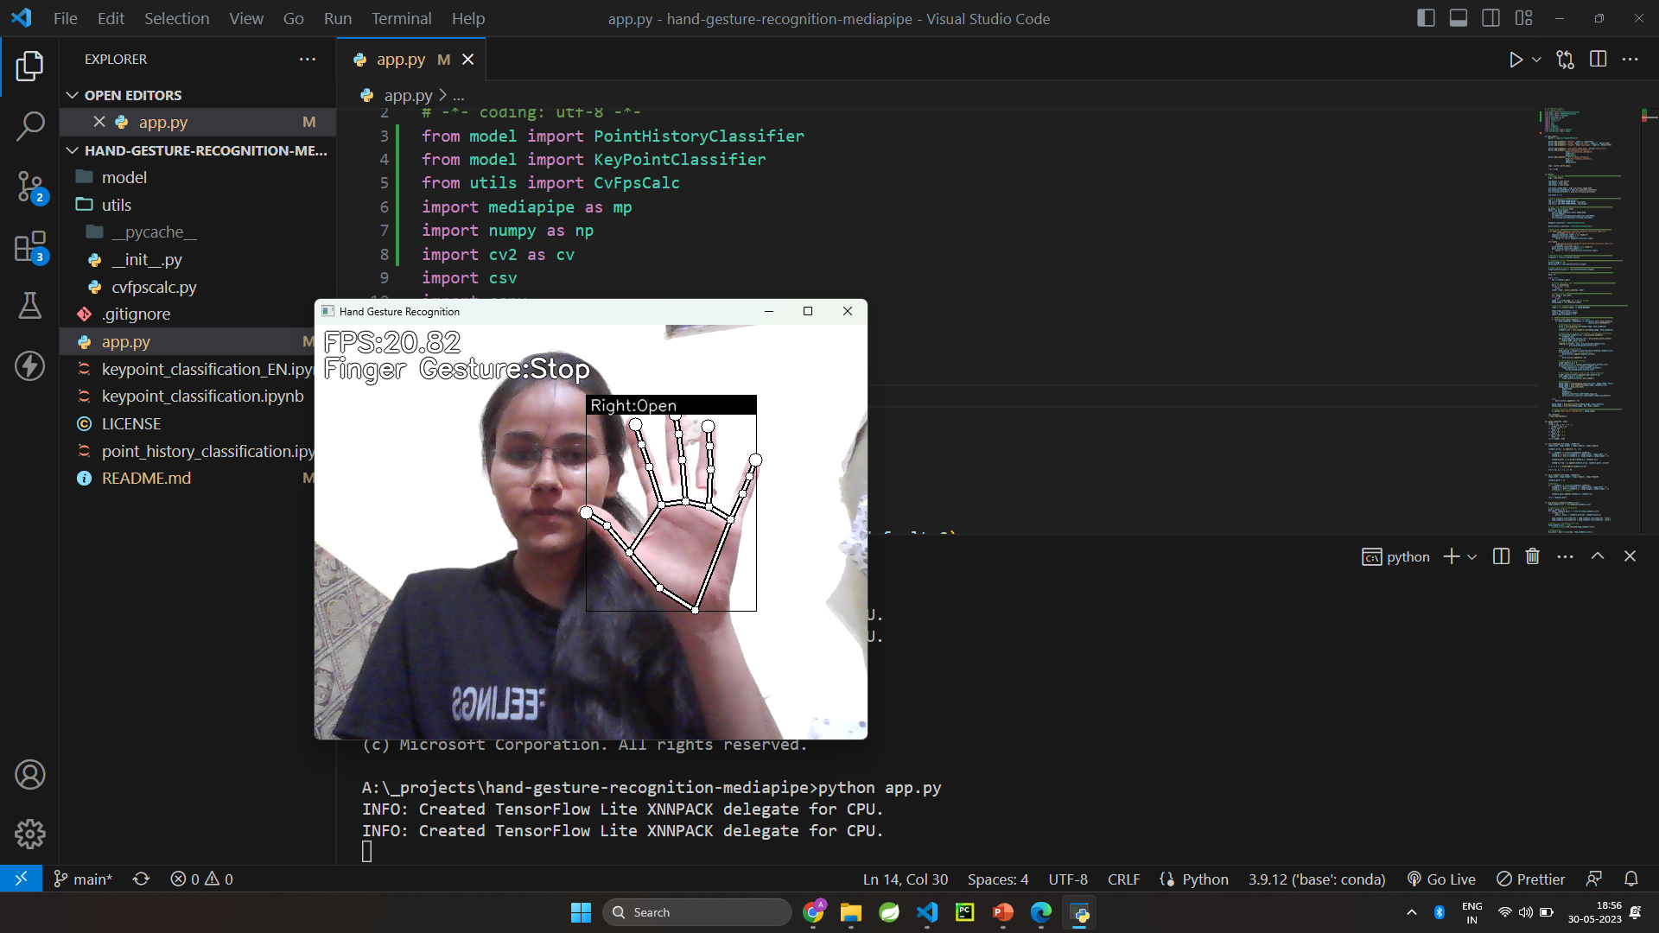

Slide 11
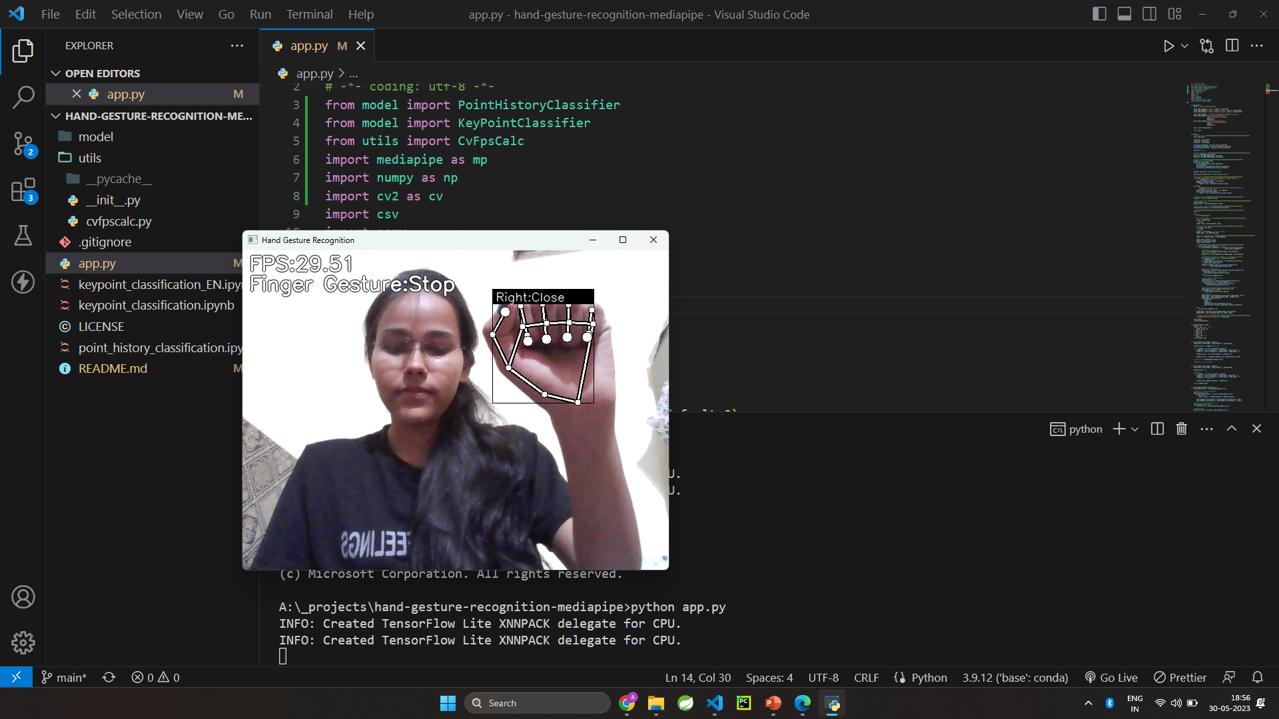

Slide 12
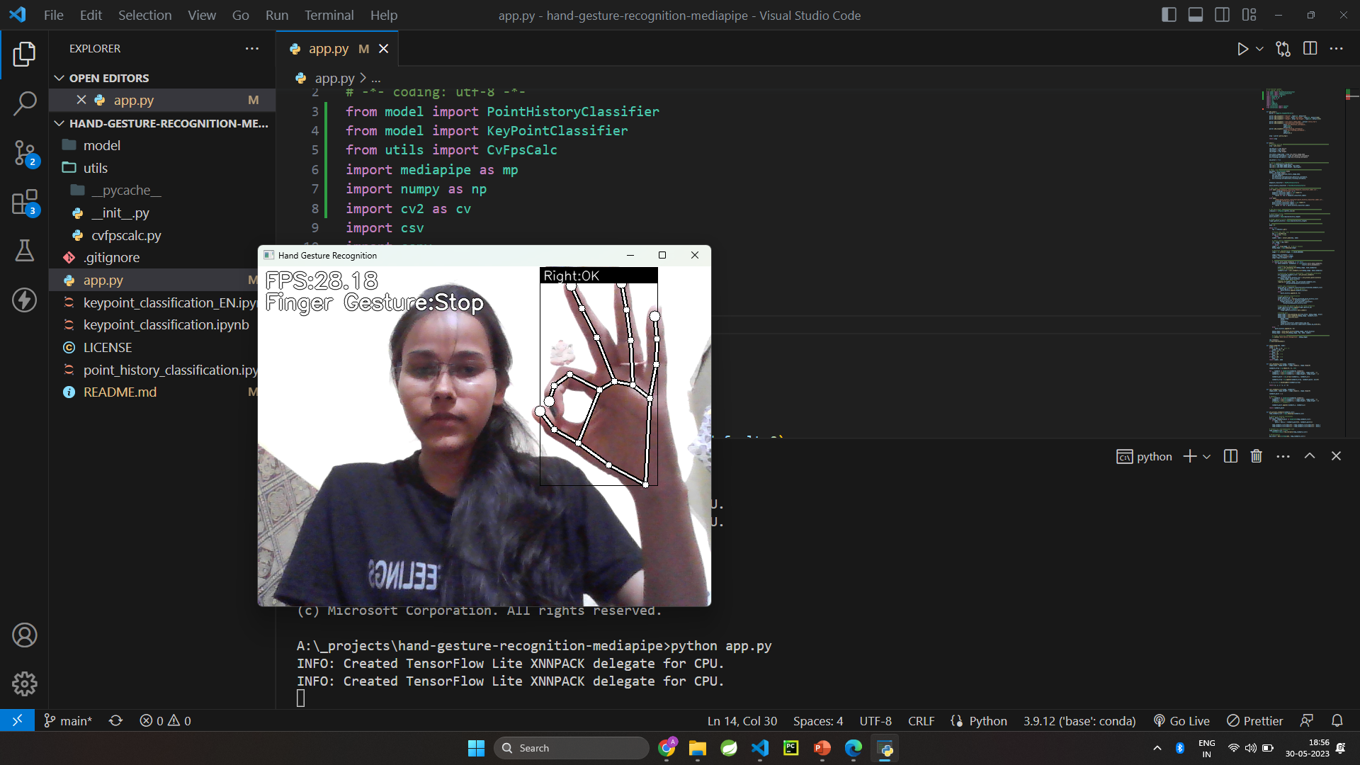

Slide 13
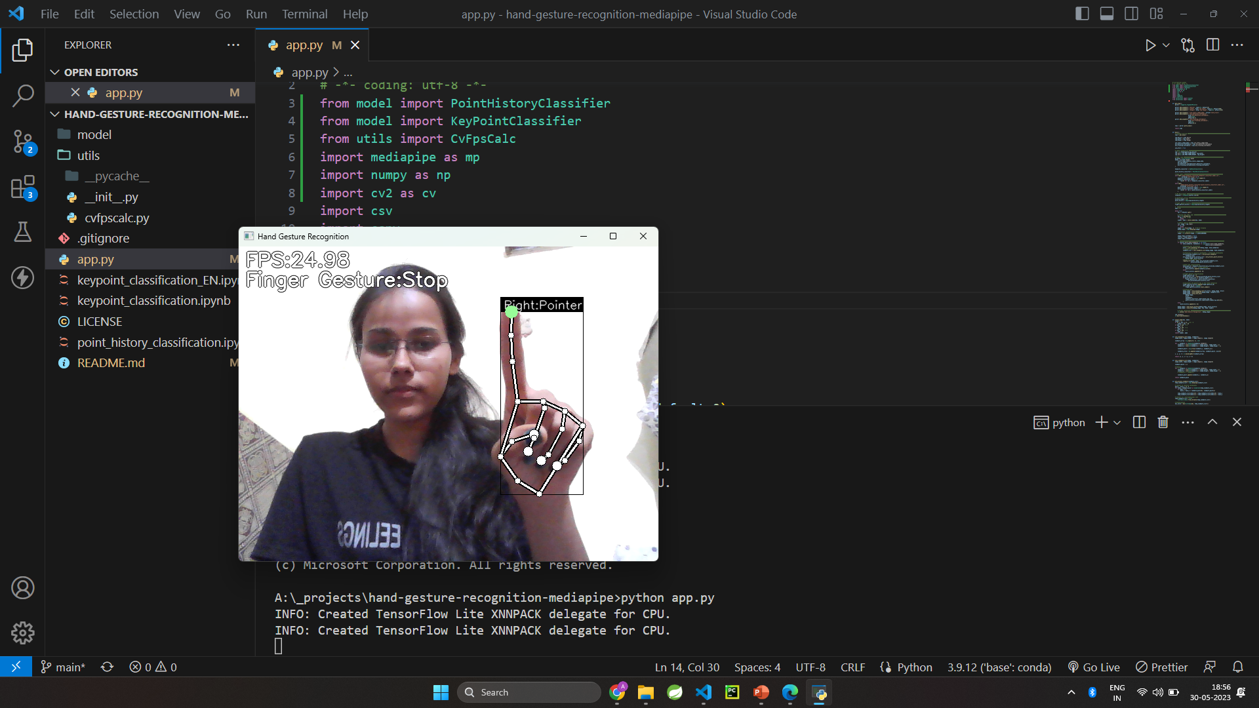

Slide 14
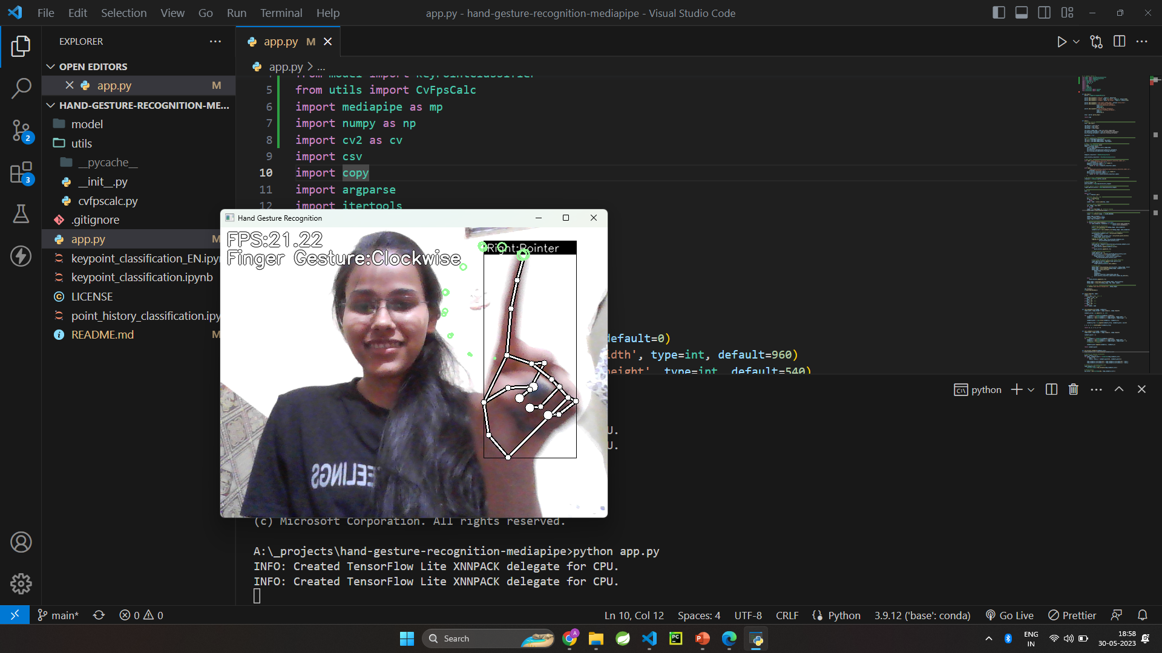

Slide 15
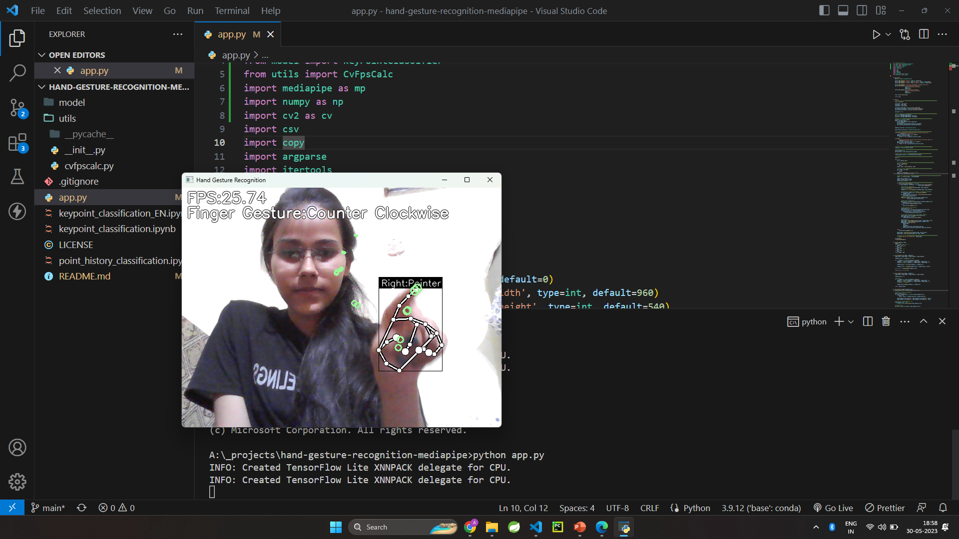

Slide 16
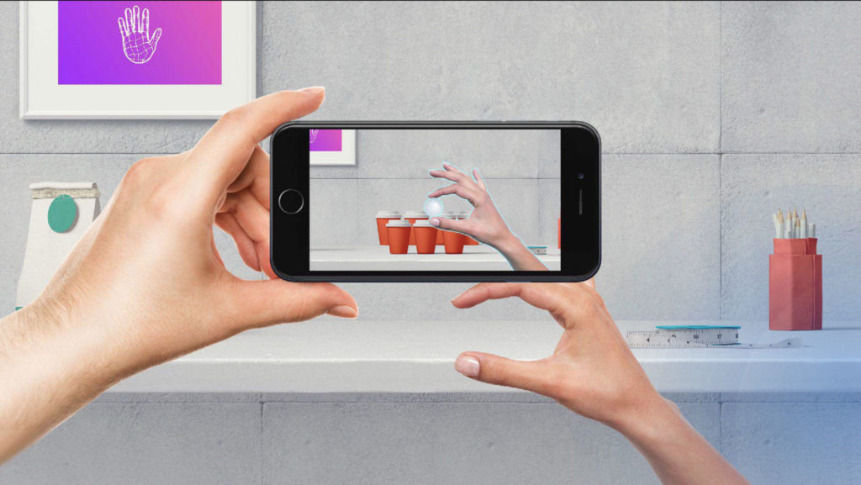
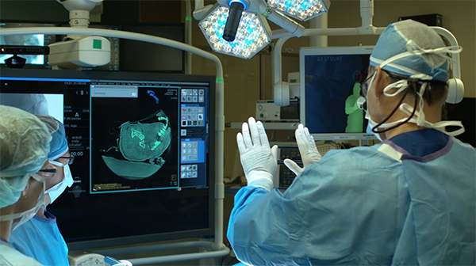
Future Scope
1.Augmented and Virtual Reality (AR/VR):
2. Healthcare and Rehabilitation:

Slide 17
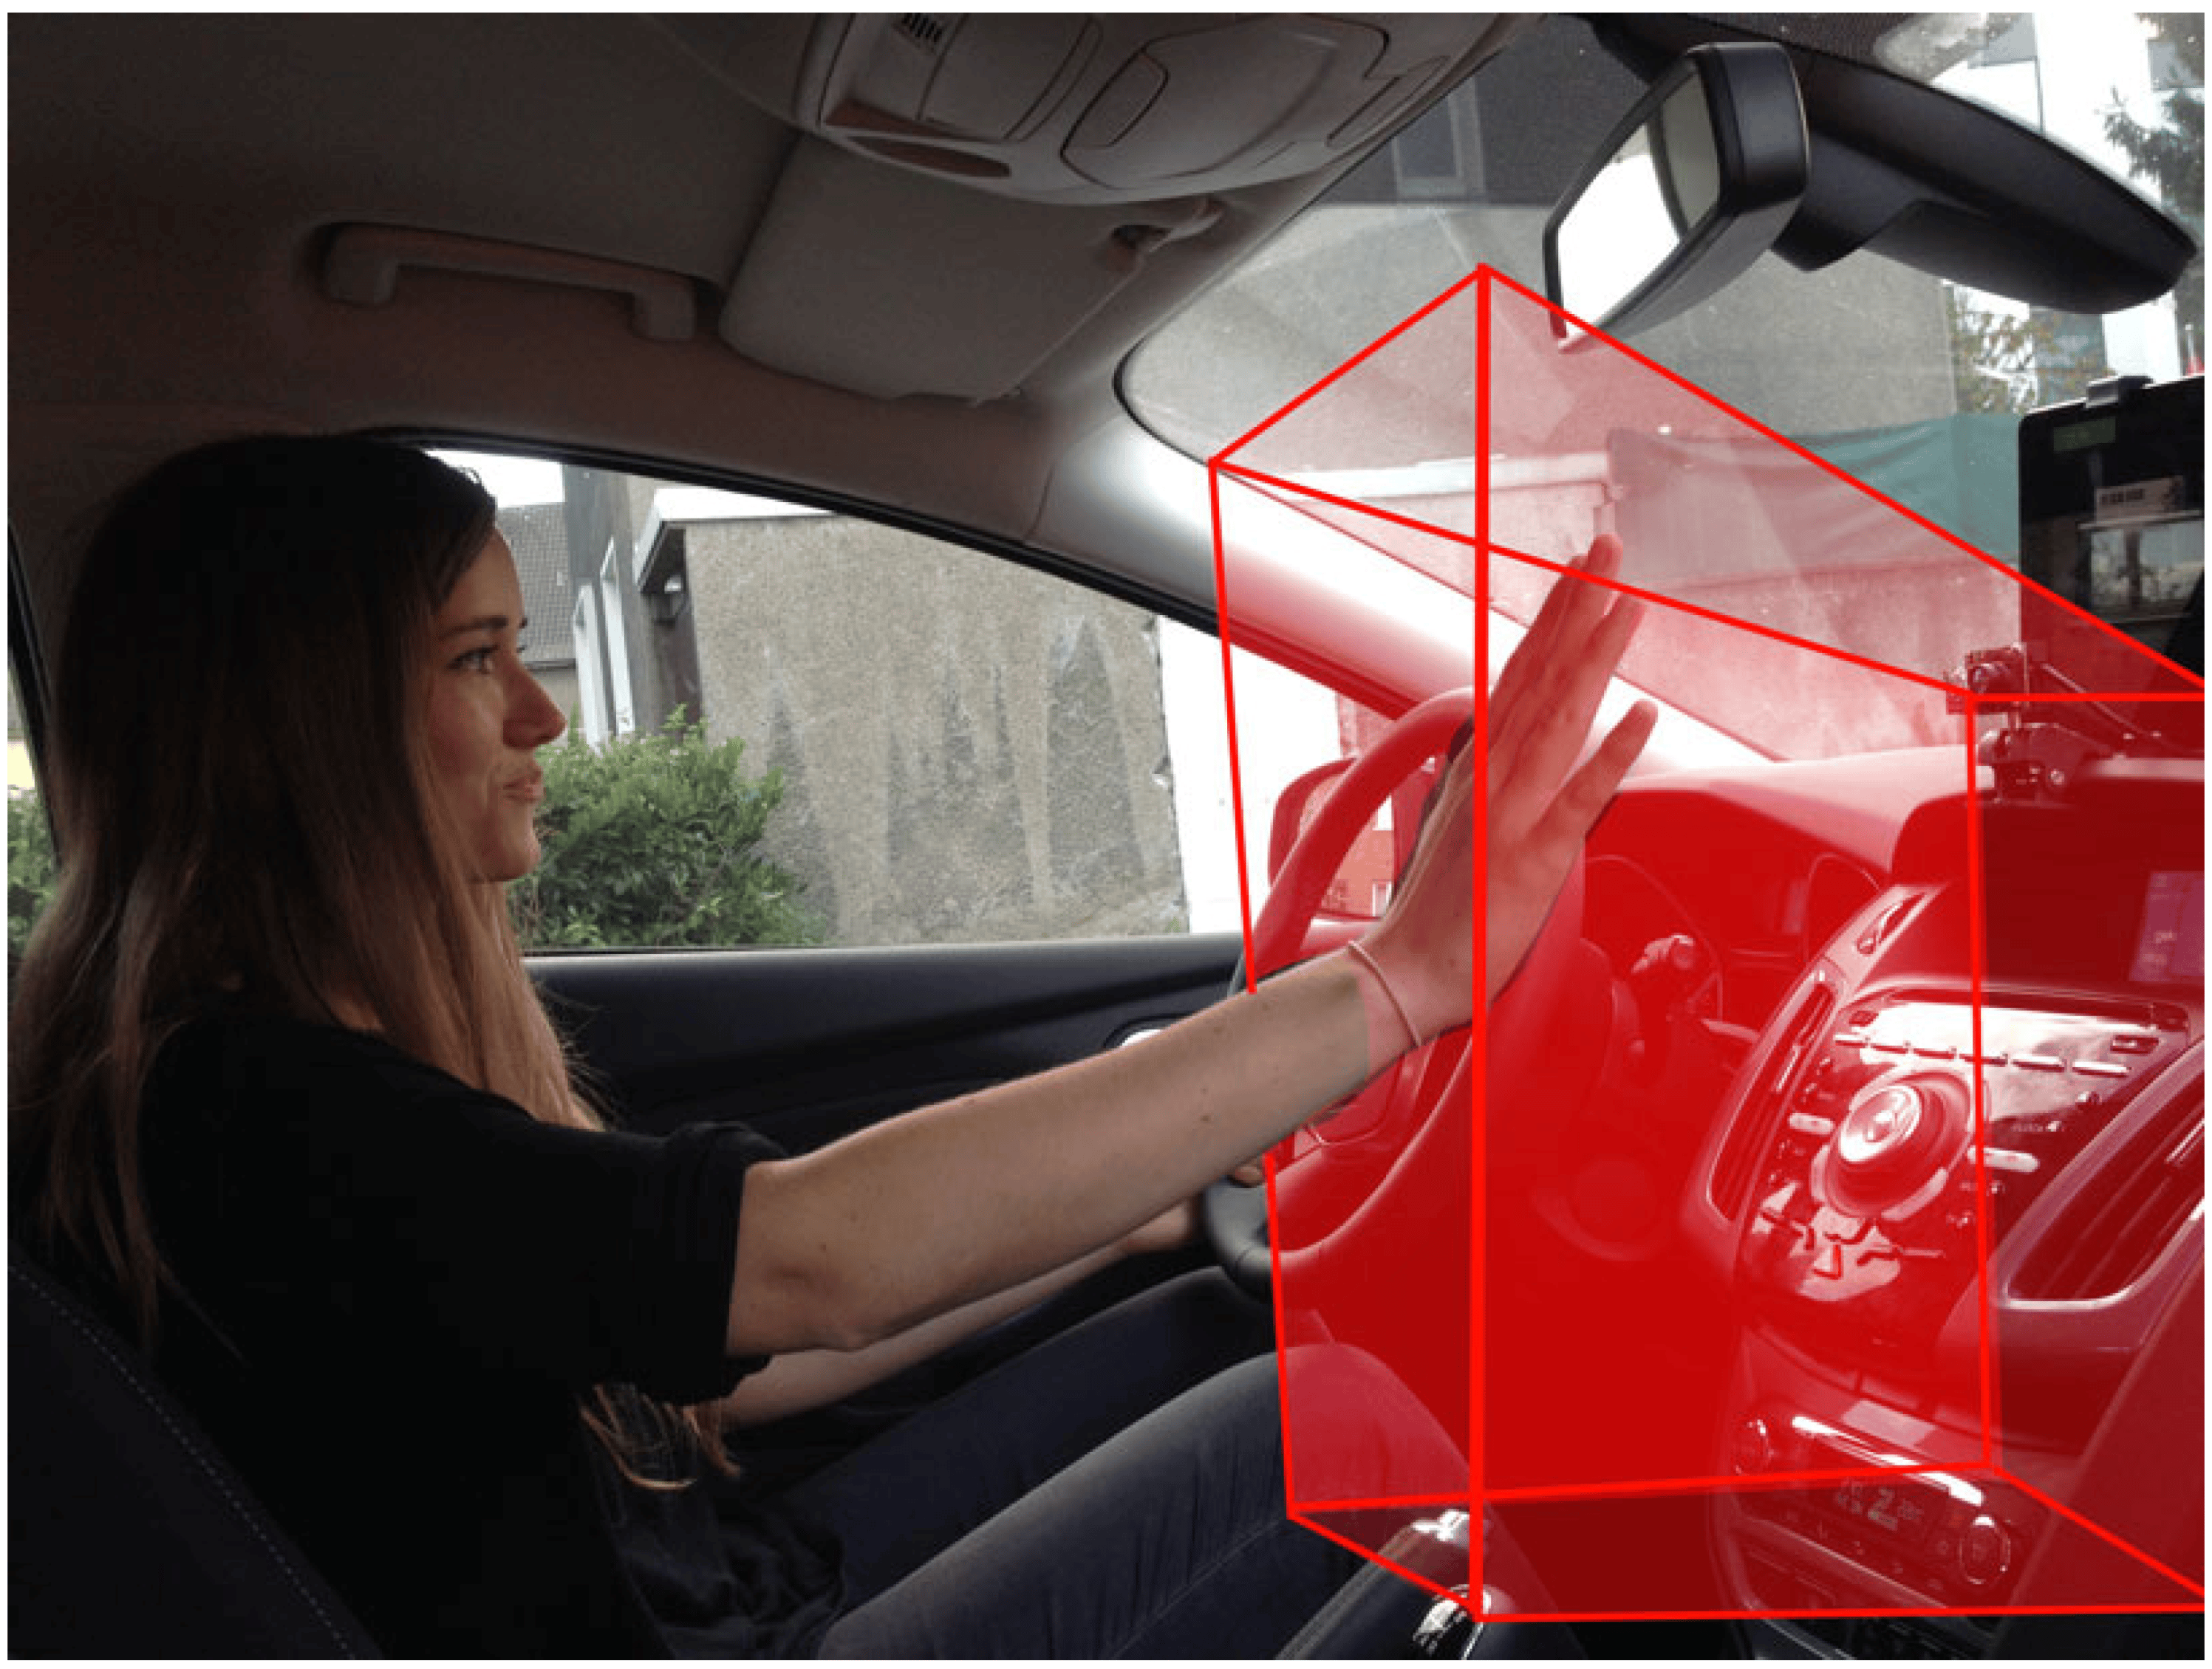
3.Automotive Industry:
4.Robotics and Automation:

Slide 18
Conclusion
Robust against similar postures in different light conditions and backgrounds
Fast detection process, allows the real time video application with low cost sensors, such as PC and Webcam.

Slide 19
Thank you

